Slide 1


Mercury Tours
IGATE is now a part of Capgemini

Slide 2
TEAM MEMBERS
NAME - SURAJ SINGH
EMPLOYEE ID - 160913
NAME - TARANG GUPTA
EMPLOYEE ID - 160912
NAME - VAIBHAV JAGDE
EMPLOYEE ID - 161360
NAME - VARTIKA GARG
EMPLOYEE ID - 161361
NAME - VISHAL VISHWAKARMA
EMPLOYEE ID - 160730

Slide 3
OVERVIEW OF THE PROJECT
Mercury Tours is the online travel portals, offering flight booking, cruise booking and some exciting offers for holiday in India and abroad.
The services provided by the website are :
The HOME page displays all the categories that are there in the website.
The SIGN-ON will provide access to the registered members by giving the valid user name and password.
If the user is not the registered member then user can create an account by clicking on REGISTER option.
The CRUISES option will help user to book the cruise with the best deals.

Slide 4
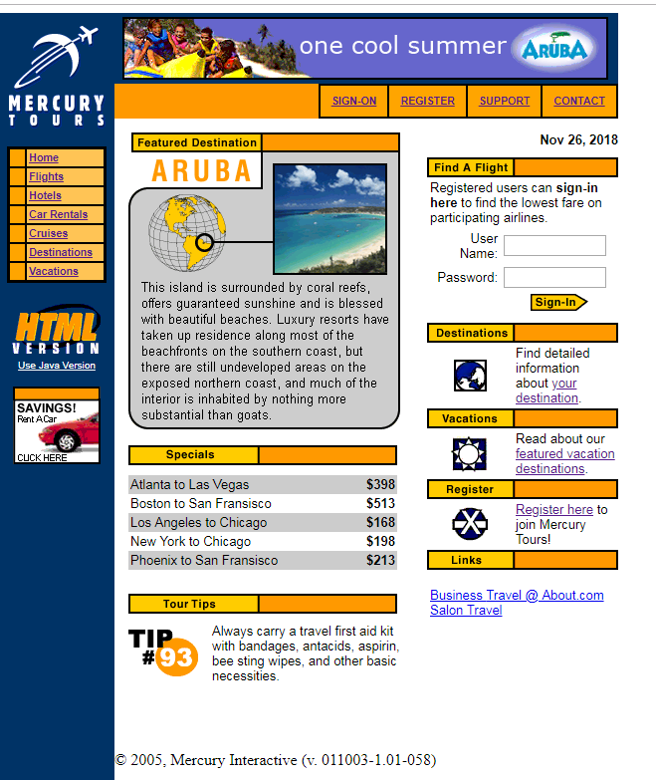
OVERVIEW OF THE PROJECT (cont.)
HOME PAGE

Slide 5
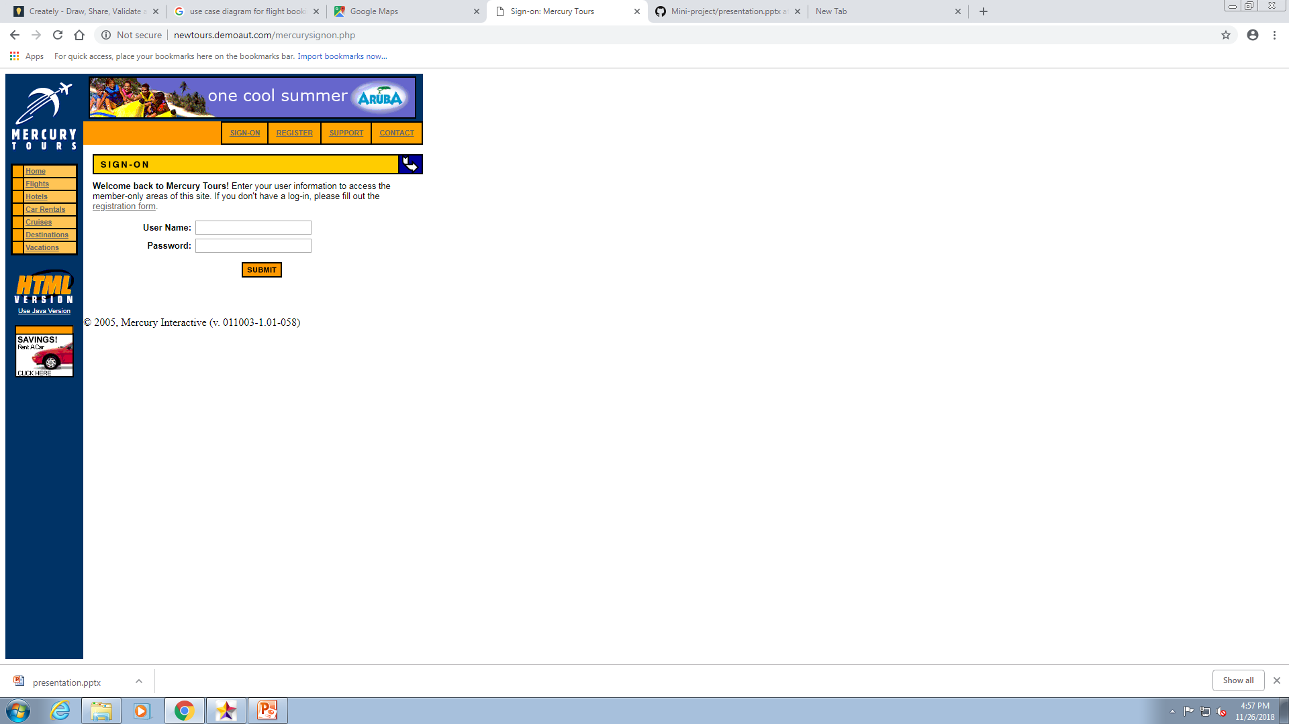
OVERVIEW OF THE PROJECT (cont.)
SIGN-ON

Slide 6
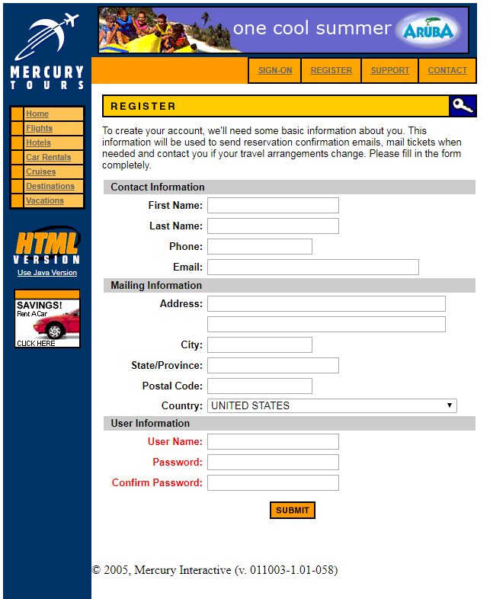
OVERVIEW OF THE PROJECT (cont.)
REGISTER

Slide 7
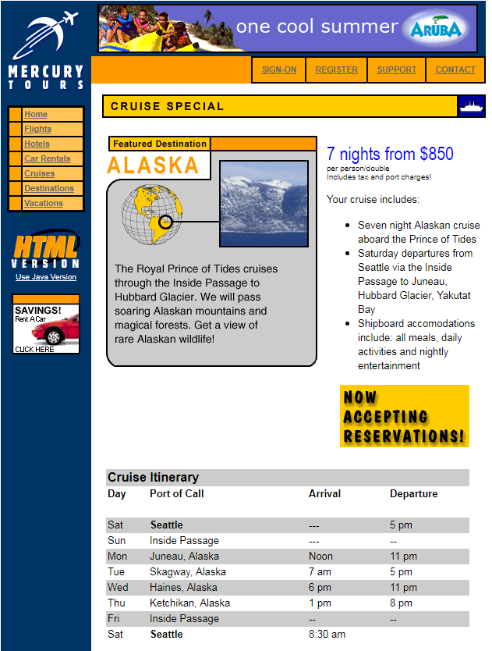
OVERVIEW OF THE PROJECT (cont.)
CRUISES

Slide 8
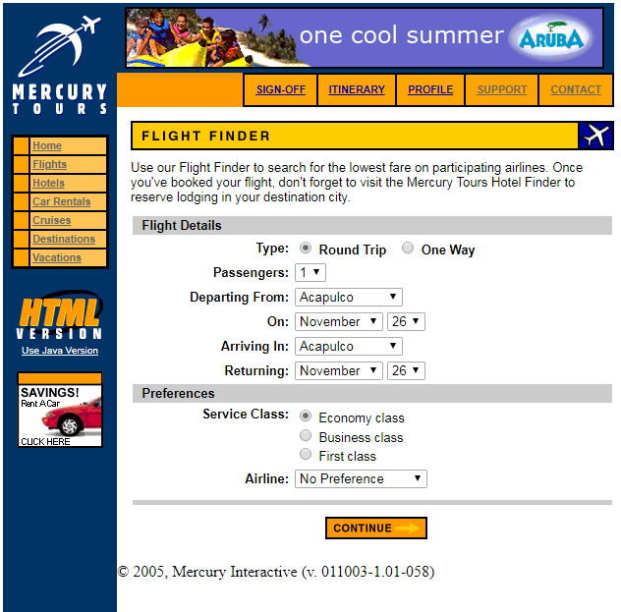
OVERVIEW OF THE PROJECT (cont.)
FLIGHT BOOKING

Slide 9
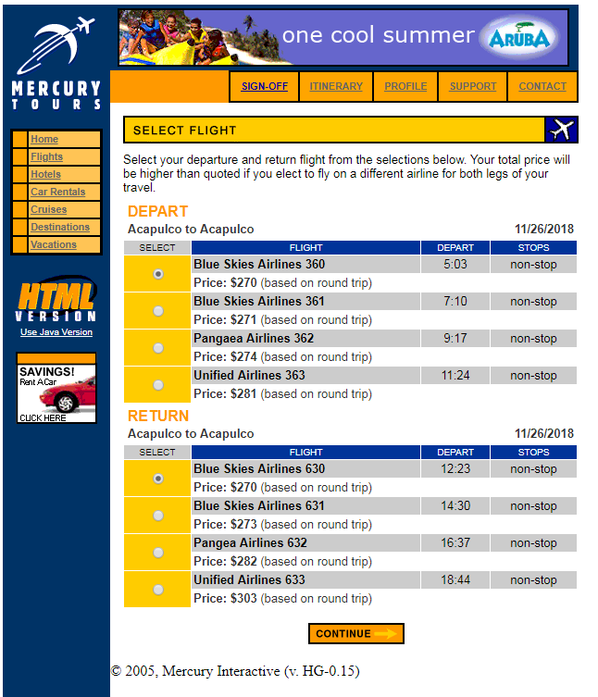
OVERVIEW OF THE PROJECT (cont.)
FLIGHT BOOKING CONTINUED

Slide 10
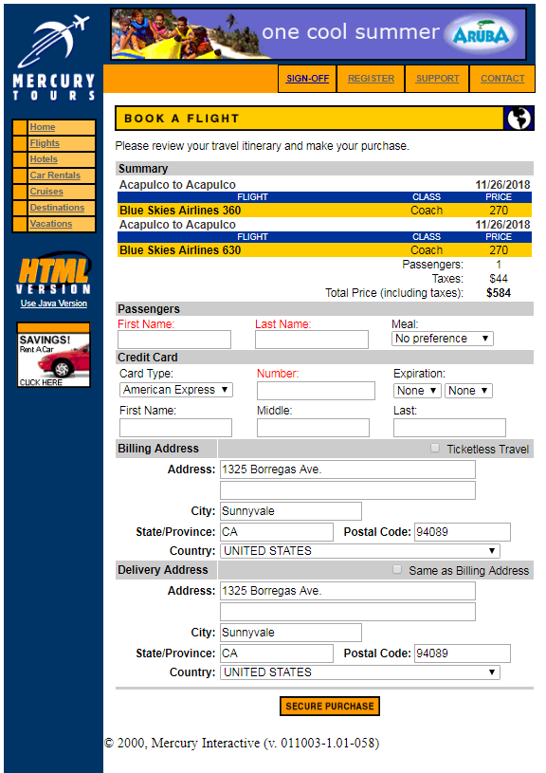
OVERVIEW OF THE PROJECT (cont.)
FLIGHT BOOKING CONTINUED

Slide 11
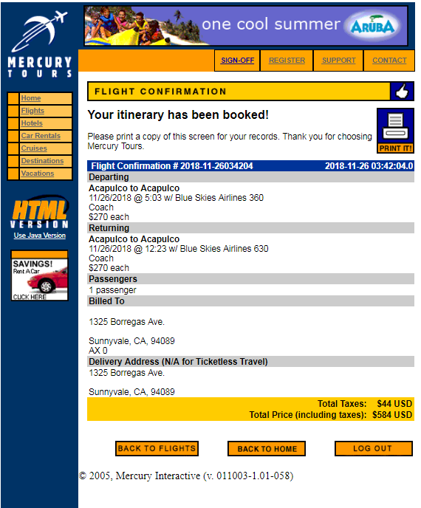
OVERVIEW OF THE PROJECT (cont.)
FLIGHT BOOKING CONTINUED

Slide 12
Actors
User
Admin
Bank Application

Slide 13
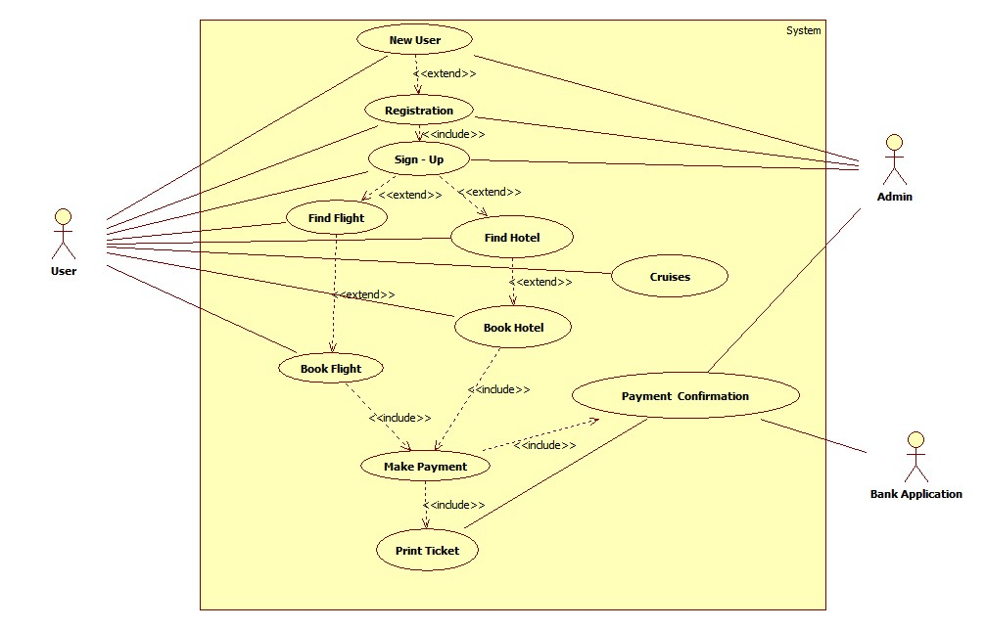
Use Case Diagram

Slide 14
TEST CASES

Slide 15
DFDR

Slide 16
Defects Found…

Slide 17
Application link

Slide 18
Test Case Adequacy :

Slide 19
Test Case Effectiveness:

Slide 20
Tracebelity Matrix

Slide 21
CONCLUSION
There are some modules in our website which are under construction and are need to be worked on.

Slide 22
Thank You

